Slide 1
Basic electronics terms
Name : Parmar TIRth
Company : ECO paradigm
Date : 09-02-2024

Slide 2
Terms
Filters
Types of filters
Rectifier & Rectification
Capacitor
Amplifier & Amplification
SMPS

Slide 3
Filters
A filter is basically frequency selective circuit.
A filter is a circuit of passing certain frequencies while attenuating other frequencies.
16KHz
Filter (15-20KHz)
12KHz
16 KHz
24KHz

Slide 4
Filter types
Types
Based on their construction
Based on their frequency response
Passive filters
Active filters
Low pass filters
High pass filters
Band pass filters
Band stop filters

Slide 5
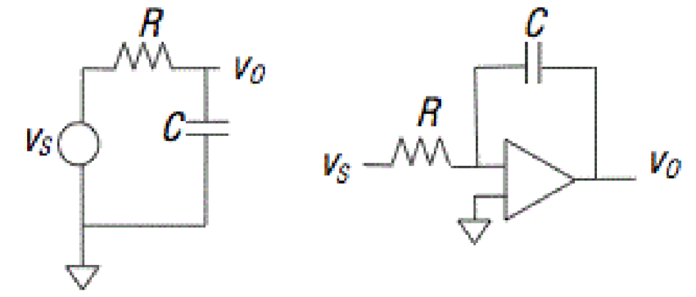
Based on their construction
Passive filters
Passive filters only use passive components such as resistors, capacitors, and inductors.
Active filters
Active filters use active components like op-amps or transistors along with passive components like resistors and capacitors.
Passive filter
Active filter

Slide 6
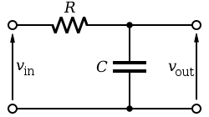
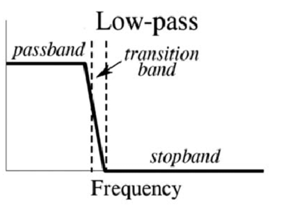
Based on their frequency response
Low pass filter
A low pass filter allows signals with frequencies below a certain cutoff frequency to pass through while attenuating signals with frequencies above the cutoff frequency.

Slide 7
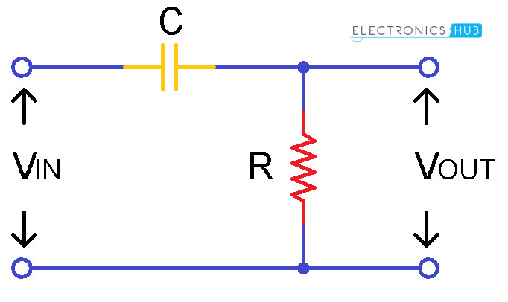
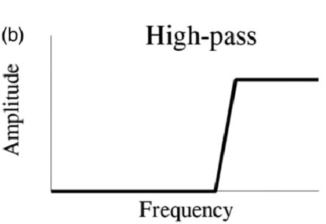
High pass filter
A high pass filter allows signals with frequencies above a certain cutoff frequency to pass through while attenuating signals with frequencies below the cutoff frequency.

Slide 8
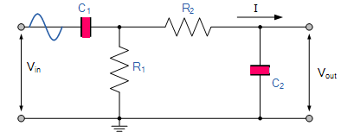
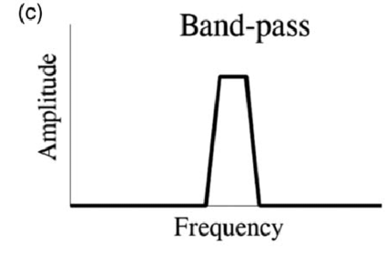
Band pass filter
Passes a specific range or band of frequencies while attenuating frequencies outside that range.

Slide 9
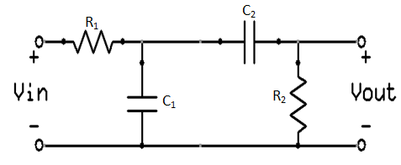
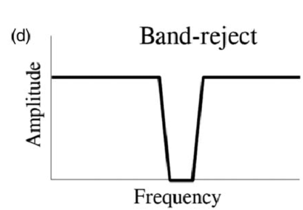
Band reject filter
Attenuates a specific range or band of frequencies while passing frequencies outside that range.

Slide 10
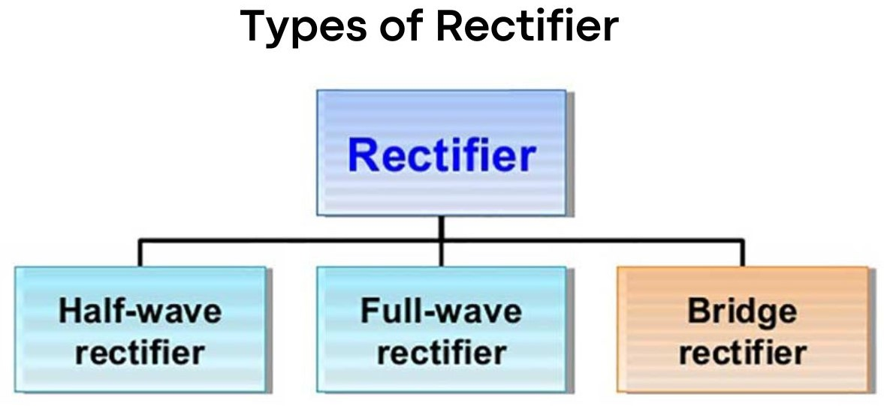
Rectification & Rectifier
A rectifier is an electronic device that converts an alternating current into a direct current by using one or more P-N junction diodes. A diode behaves as a one-way valve that allows current to flow in a single direction. This process is known as rectification.

Slide 11
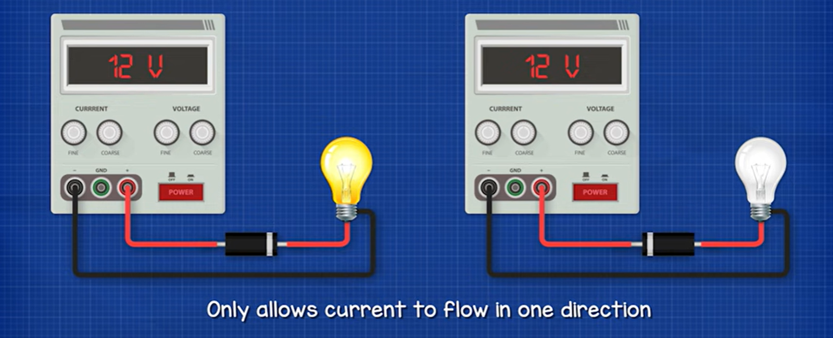
Half wave rectifier

Slide 12
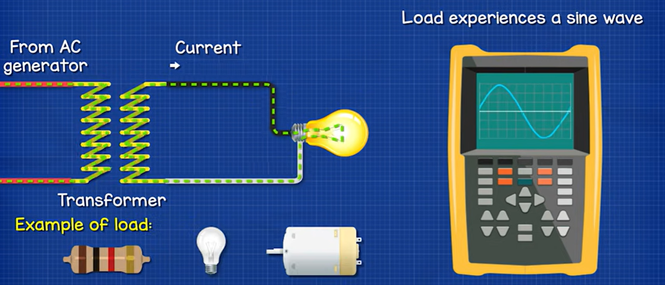
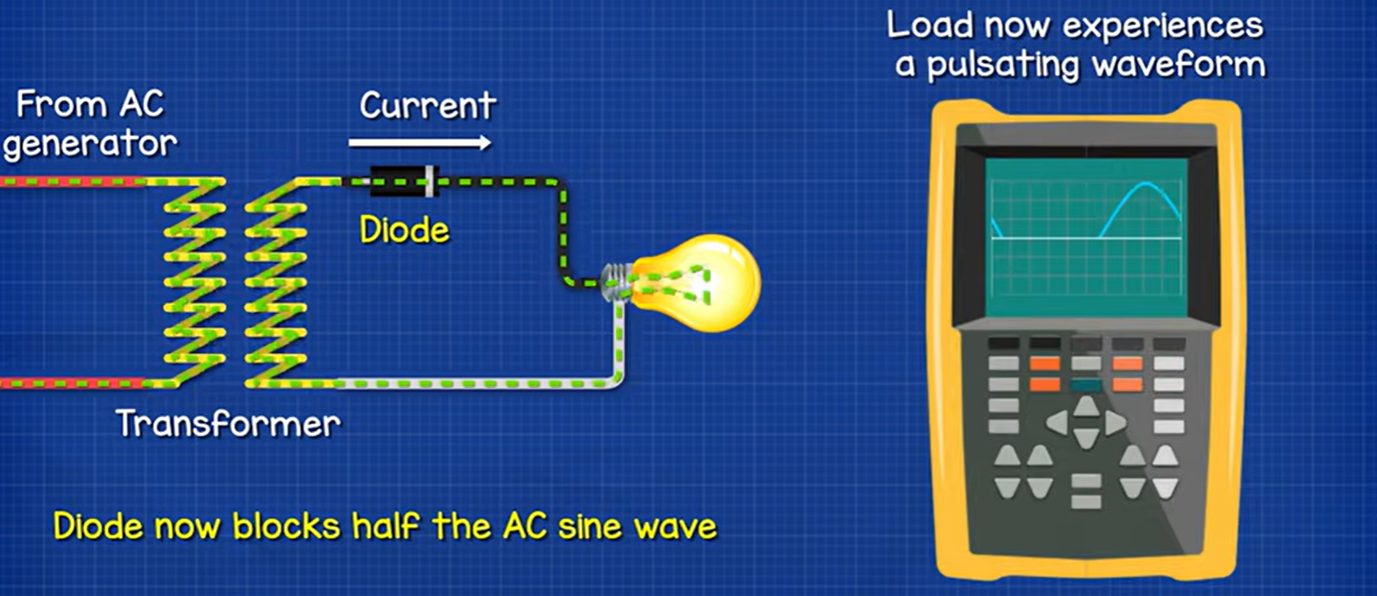

Slide 13
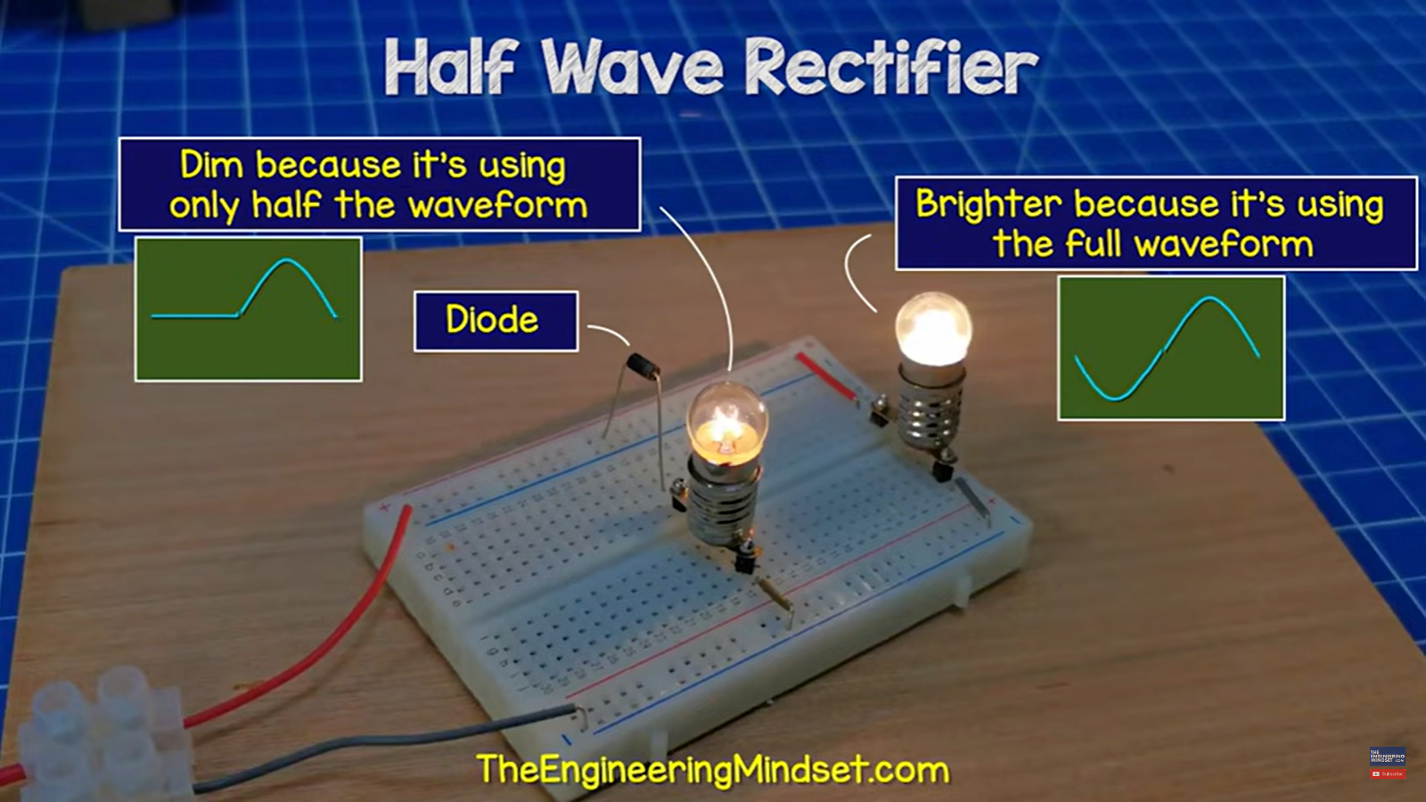

Slide 14
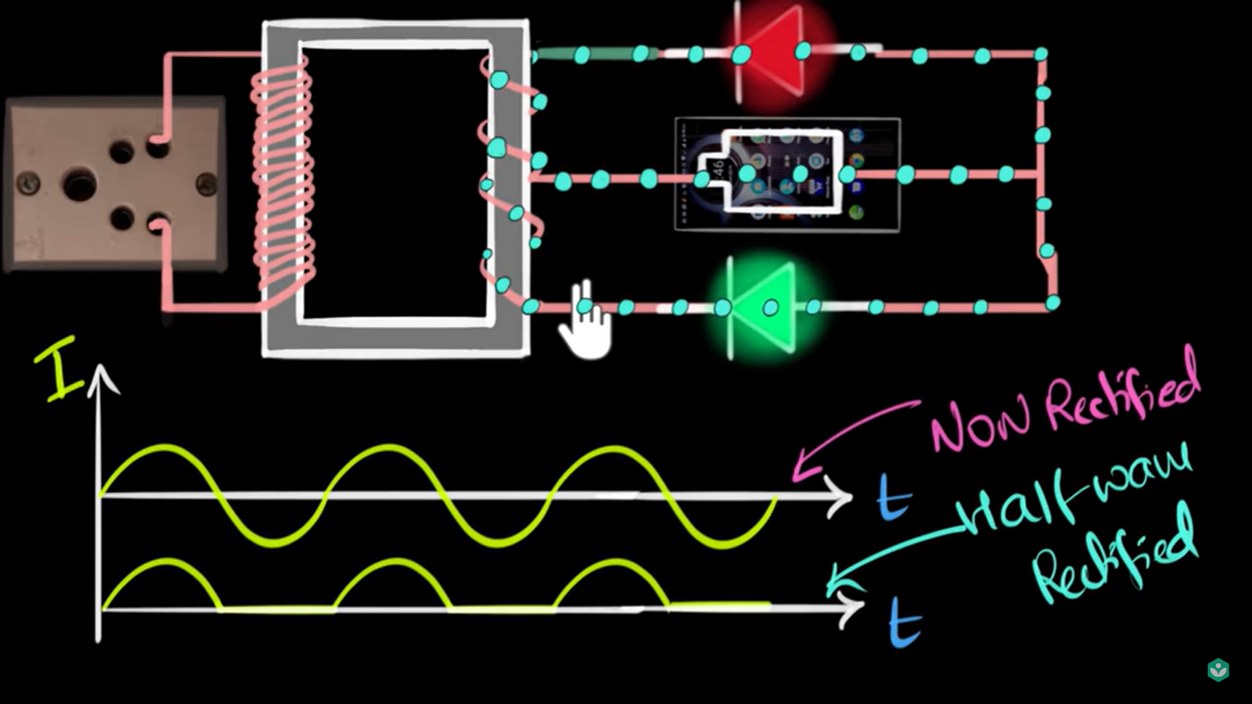
Full wave rectifier

Slide 15
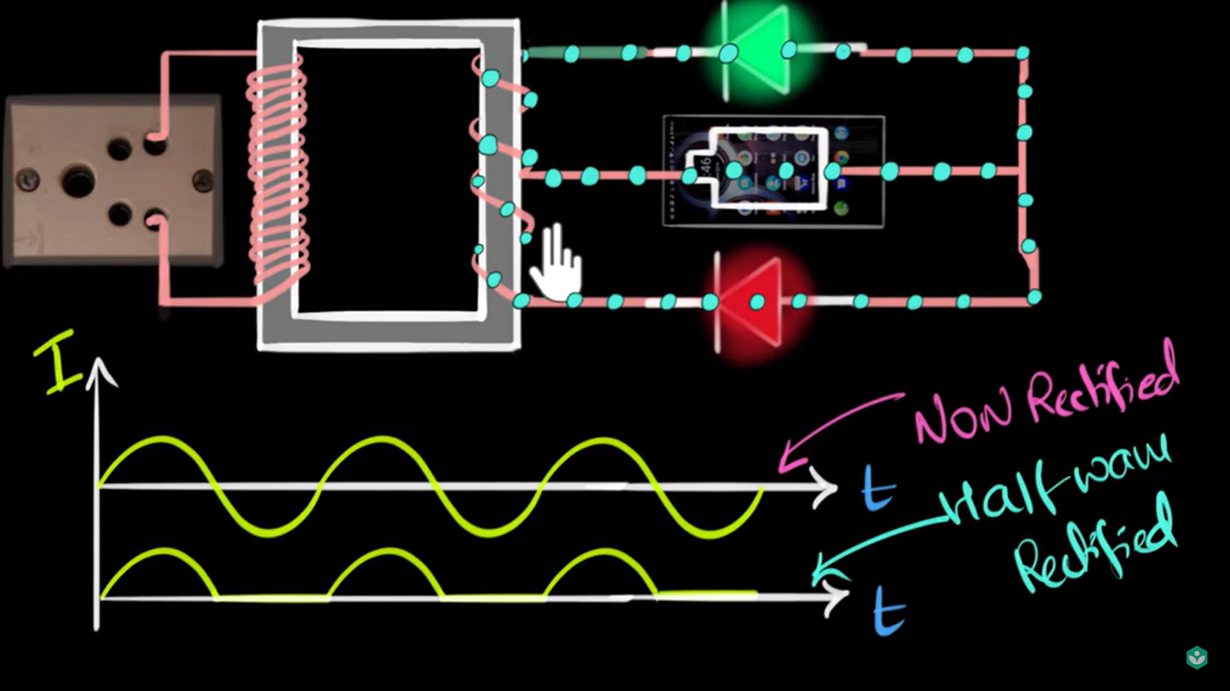

Slide 16
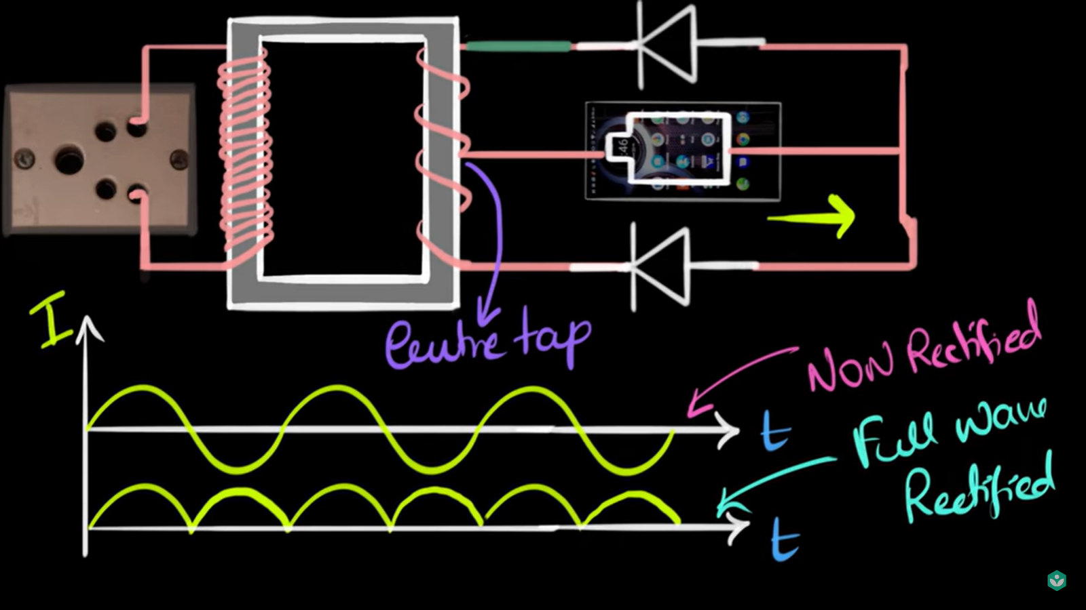

Slide 17
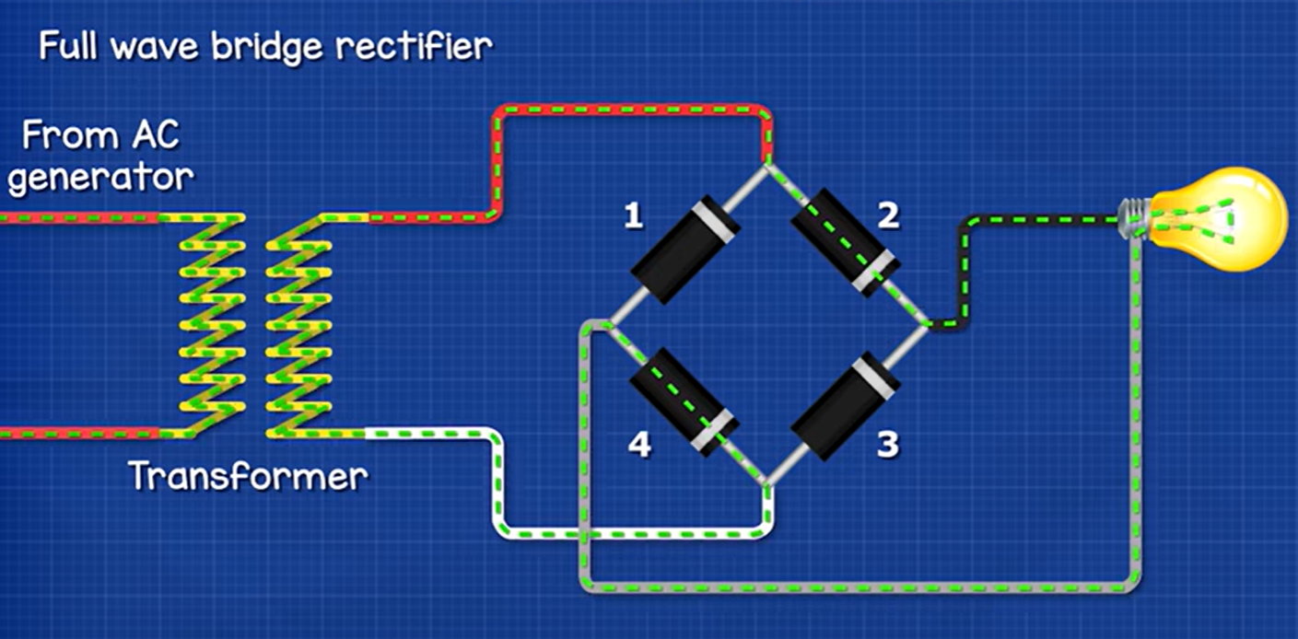
Bridge rectifier

Slide 18
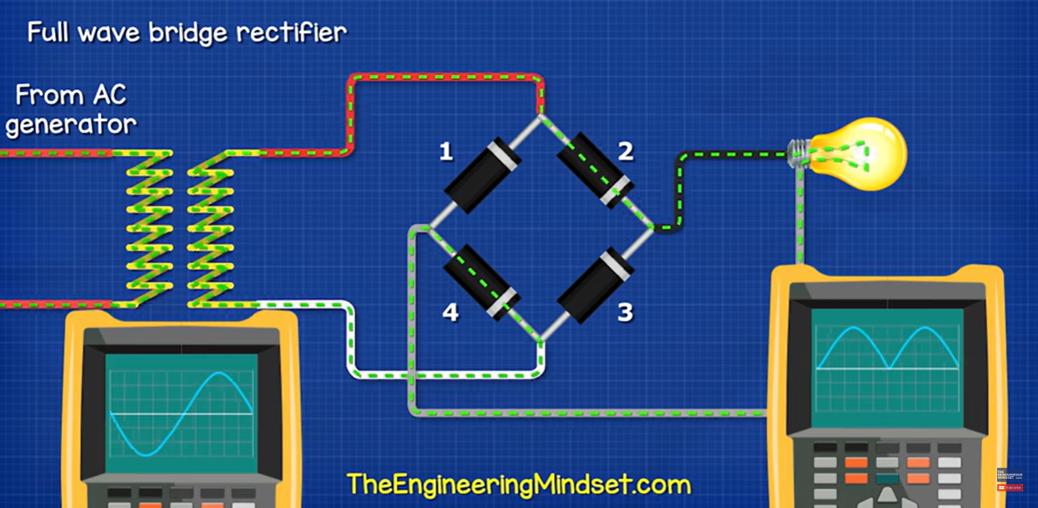
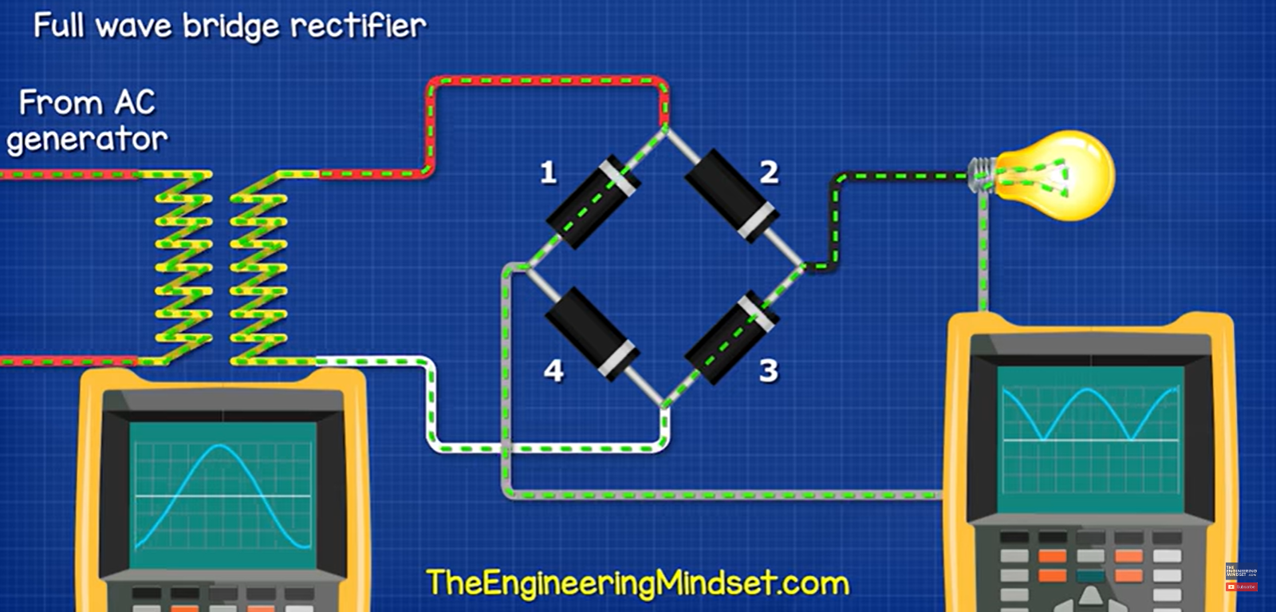

Slide 19
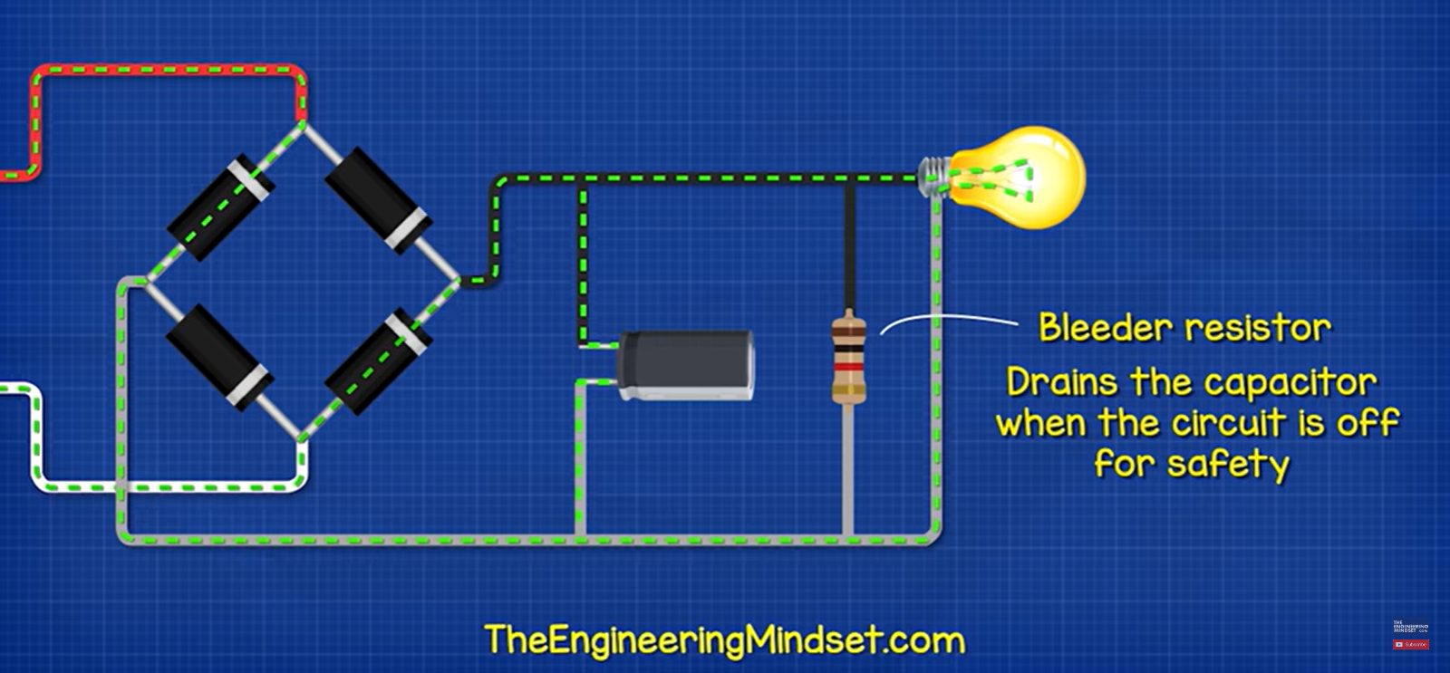
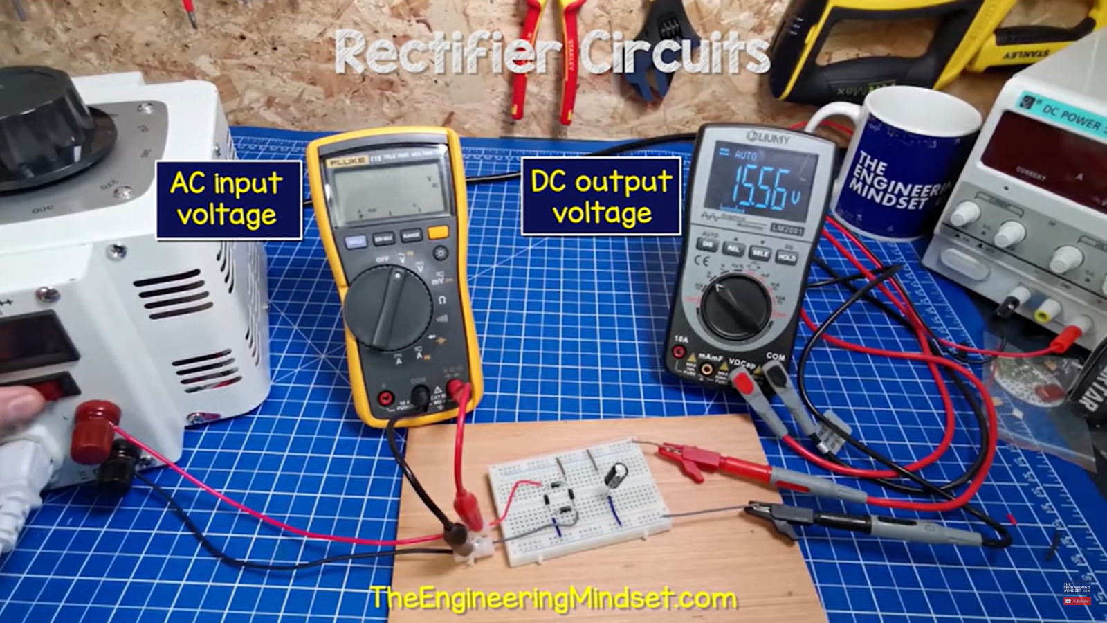
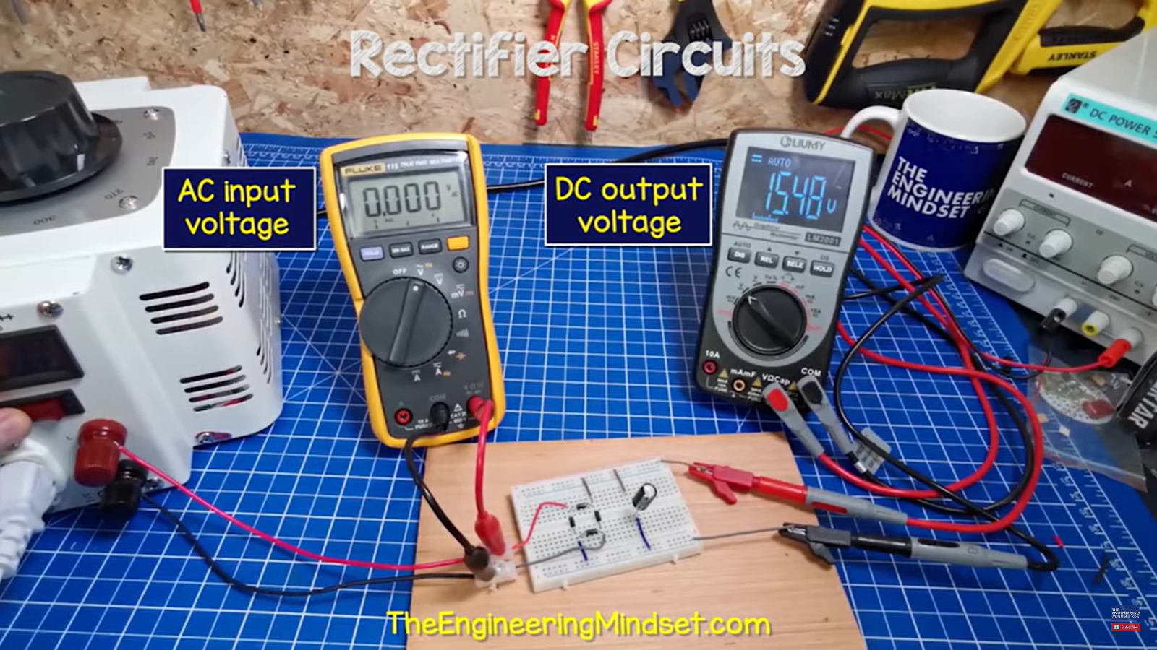
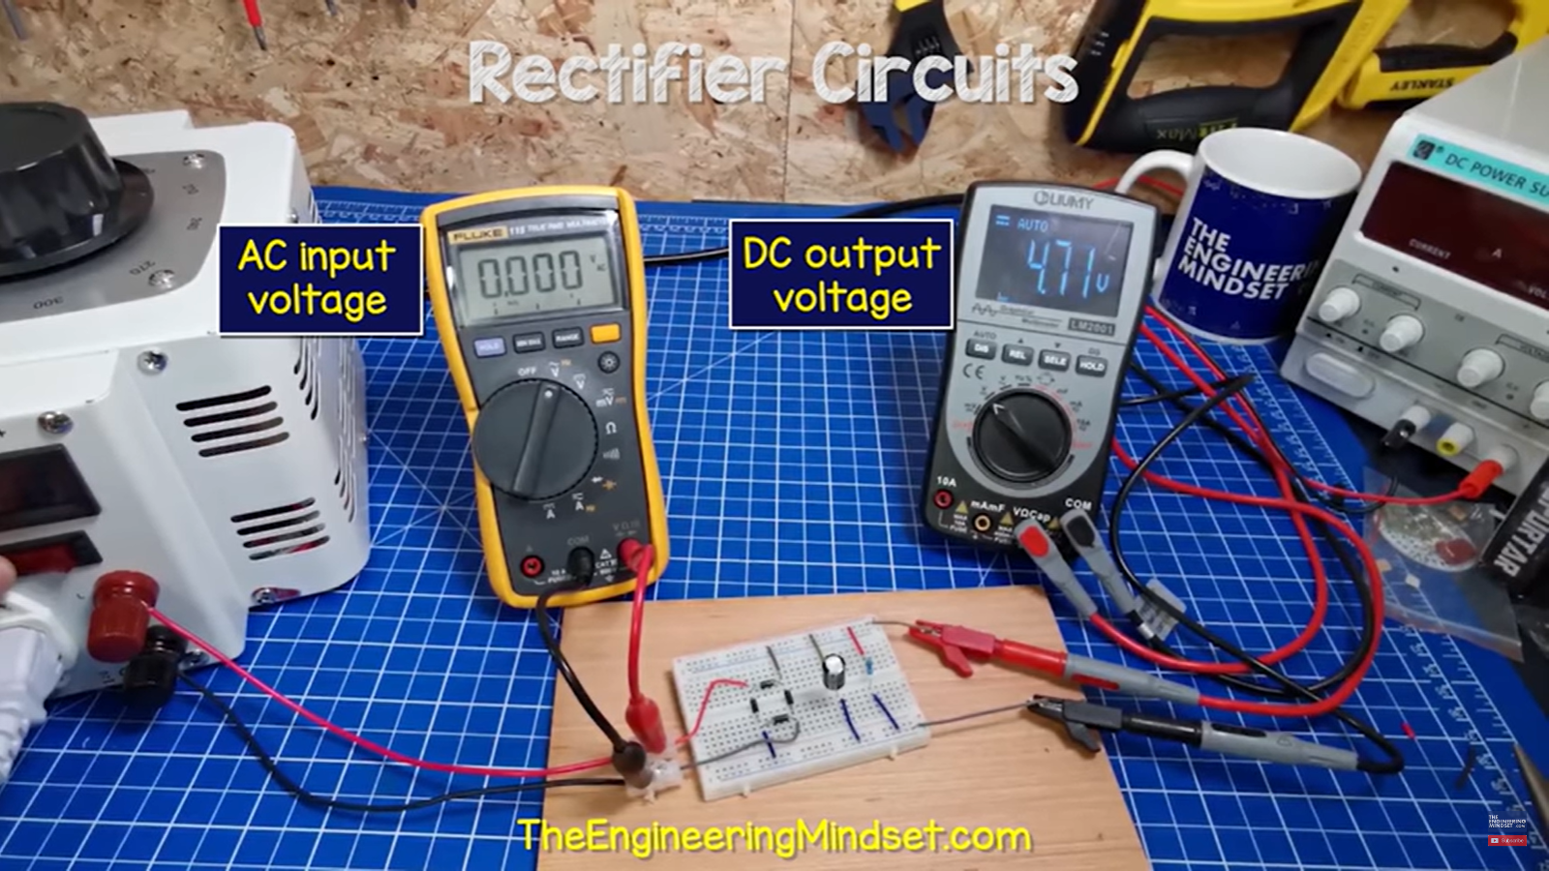

Slide 20
Amplifier & Amplification
Amplifier is electronic device or circuit that is used to increase the voltage, current and power of an input signal.
The process of increasing the parameters of that signal is called the amplification.

Slide 21
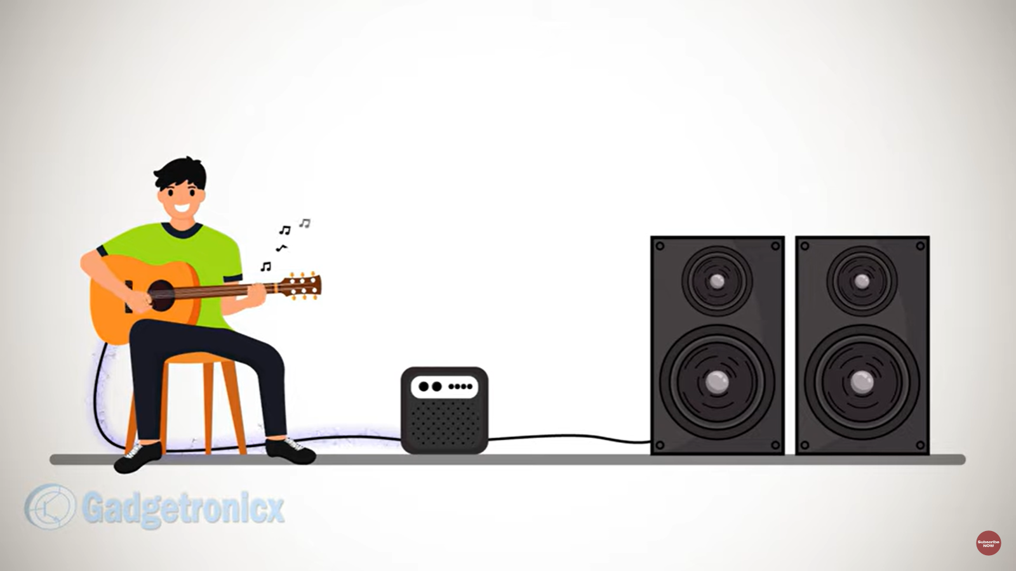

Applications

Slide 22
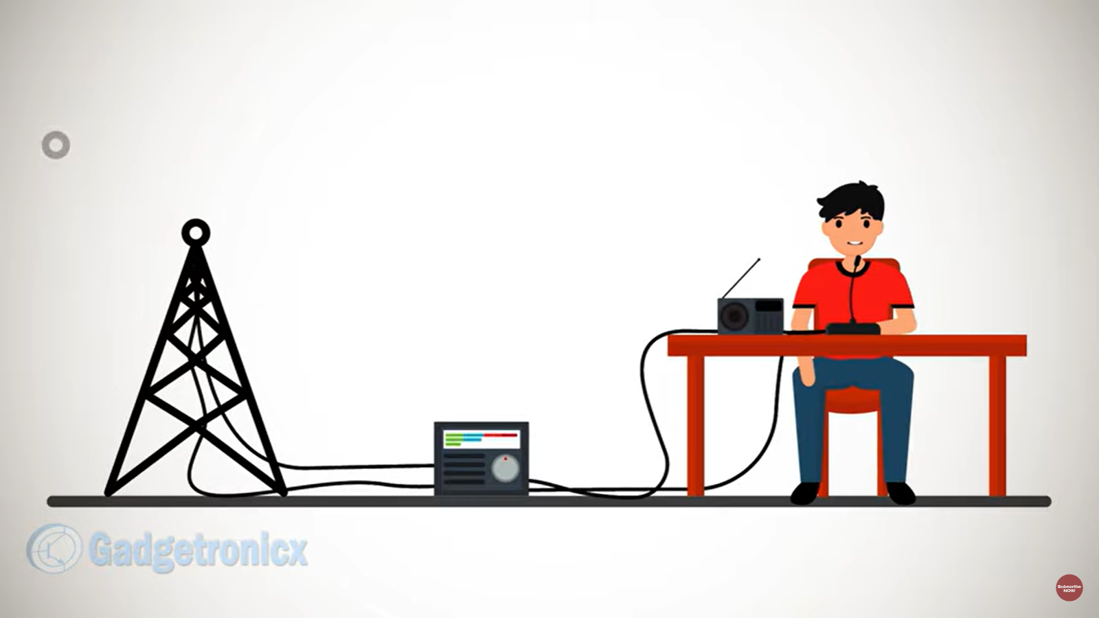
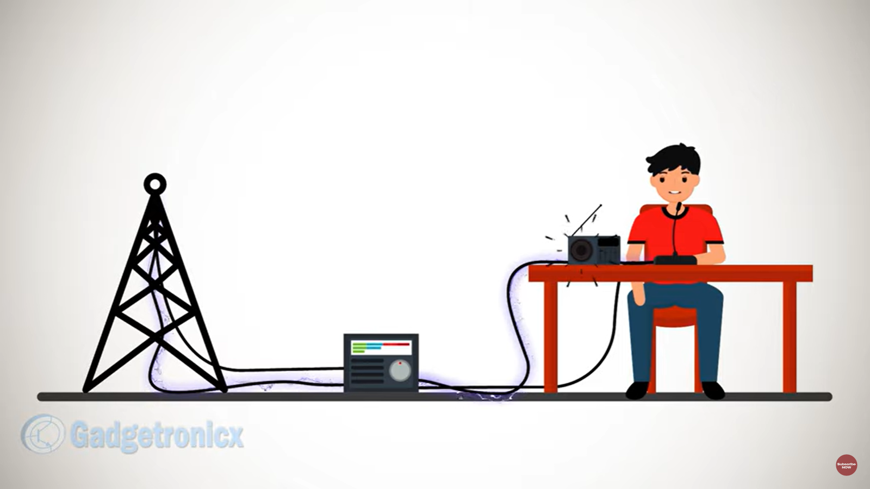
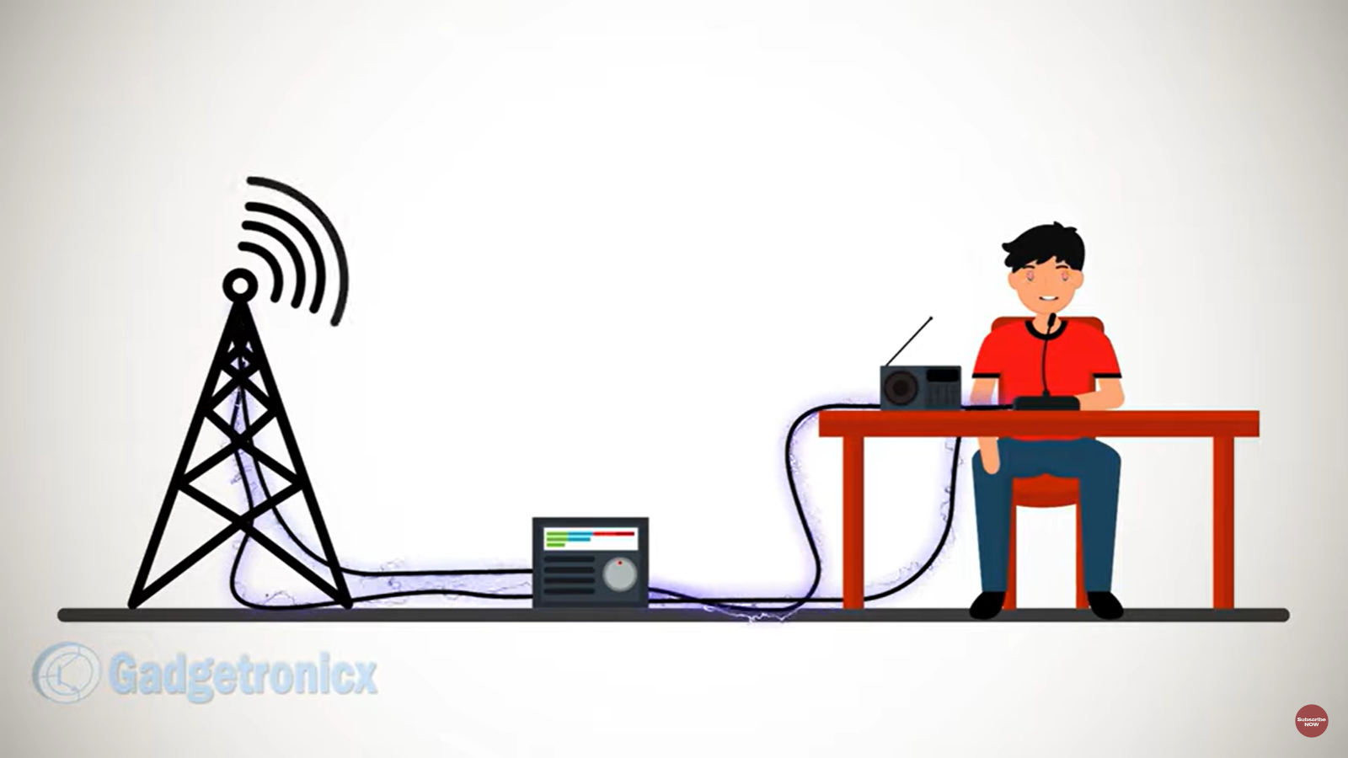

Slide 23
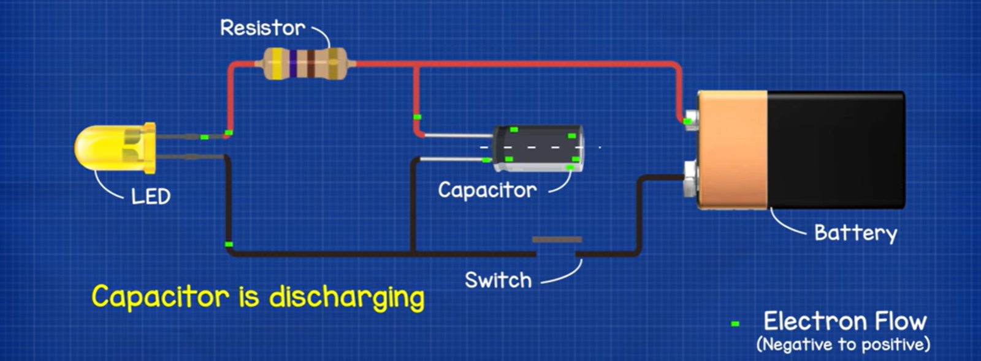
Capacitor
A capacitor is a two-terminal electrical device that can store energy in the form of an electric charge.

Slide 24
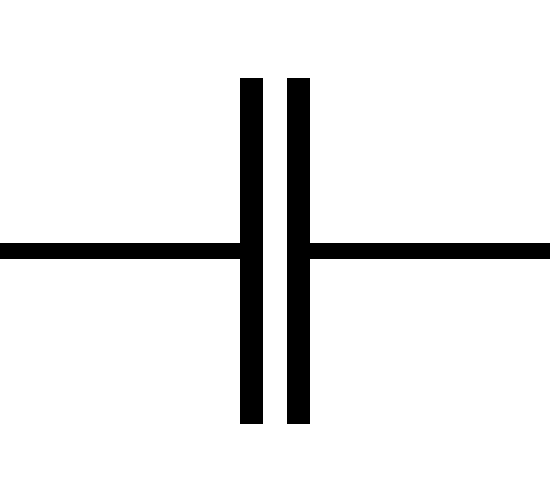
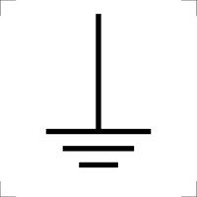
switched mode power supply
SMPS is a type of Power Supply Unit that uses switching devices to transfer electrical energy from source to load.
AC Supply
Rectifier
Filter
Active PFC
Filter
DC Output

Slide 25
Advantages
SMPS are highly efficient, typically around 70-90%, compared to linear power supplies.
SMPS are typically much smaller and lighter than linear power supplies with similar output power.
SMPS generate less heat if compared with linear power supply.

Slide 26
Thank you

